Slide 1
Embedded Software: On-board Bus Device Drivers
CSPC61 - Embedded Systems Architectures
Dr. M. Bhuvaneswari
31.03.2022

Slide 2
On-board Bus Device Drivers
Each bus is associated
Protocol is used to define how devices gain access to the bus.
The rules attached devices must follow to communicate over the bus
The signals associated with the various bus lines.
Bus protocol is supported by the bus device drivers
Include all or some combination of all of the 10 functions.
10 functions are
Bus Startup, initialization of the bus upon power-on or reset.
Bus Shutdown, configuring bus into its power-off state.
Bus Disable, allowing other software to disable bus on-the-fly.
Bus Enable, allowing other software to enable bus on-the-fly.
Bus Acquire, allowing other software to gain singular (locking) access to bus.
Bus Release, allowing other software to free (unlock) bus.
Bus Read, allowing other software to read data from bus.
Bus Write, allowing other software to write data to bus.
Bus Install, allowing other software to install new bus device on-the-fly for expandable buses.
Bus Uninstall, allowing other software to remove installed bus device on-the-fly for expandable buses.

Slide 3
On-board Bus Device Drivers - Pseudocode Examples
How bus management on MPC860 - Pseudocode gives an example of implementing a bus initialization (Bus Startup) routine.
I²C Bus Startup (Initialization) on the MPC860
The I²C (inter-integrated circuit) protocol is a serial bus with one serial data line (SDL) and one serial clock line (SCL).
With the I²C protocol, all devices attached to the bus have a unique address (identifier), and this identifier is part of the data stream transmitted over the SDL line.
The components on the master processor that support the I²C protocol are needed to be initialized.
Integrated I²C controller
The I²C controller - transmitter registers, receiver registers, a baud rate generator, and a control unit.
The baud rate generator generates the clock signals when the I²C controller acts as the I²C bus master.

Slide 4
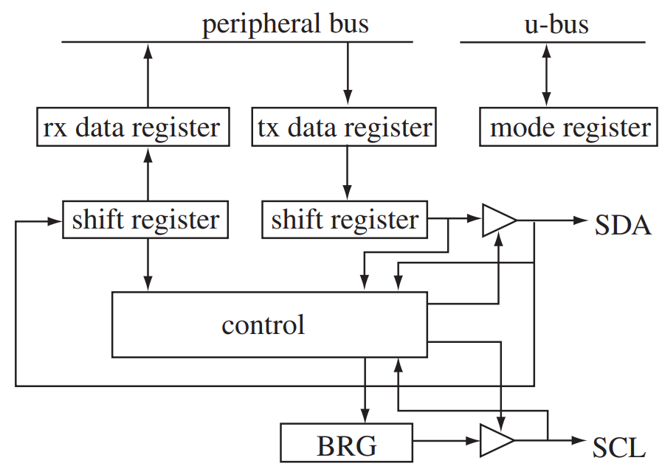
On-board Bus Device Drivers - Pseudocode Examples
I²C Bus Startup (Initialization) on the MPC860
If I²C controller is in slave mode, the controller uses the clock signal received from the master.
In reception mode, data is transmitted from the SDL line into the control unit, through the shift register, which in turn transmits the data to the receive data register.
The data that will be transmitted over the I²C bus from the PPC is initially stored in the transmit data register and transferred out through the shift register to the control unit and over the SDA line.
Initializing the I²C bus on the MPC860
Initializing the I²C SDL and SCL pins.
Initializing the I²C registers.
Initializing some of the parameter RAM.
Initializing the buffer descriptors.
I²C controller on MPC860

Slide 5
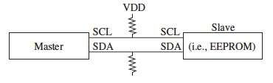
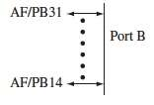
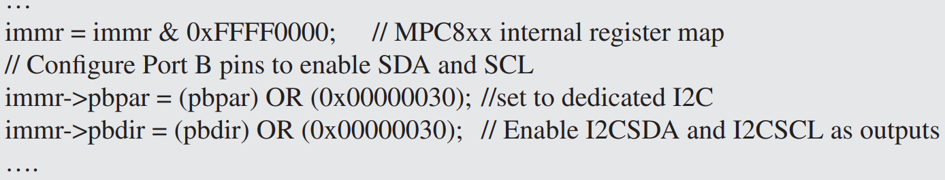
On-board Bus Device Drivers - Pseudocode Examples
I²C Bus Startup (Initialization) on the MPC860
Configuration of MPC860 I²C SDA and SCL pins
These pins are configured - the Port B general purpose I/O port.
Port B has four read/write (16-bit) control registers:
the Port B Data Register (PBDAT) - contains the data on the pin.
the Port B Open Drain Register (PBODR) - configures the pin for active output.
the Port B Direction Register (PBDIR) - configures the pin as either an input or output pin.
the Port B Pin Assignment Register (PBPAR) - assigns the pin its function (I²C, general purpose I/O, etc.)
Initializing the SDA and SCL pins - MPC860 - Pseudocode below.
SDA and SCL pins on MPC860
MPC860 Port B Pins

Slide 6

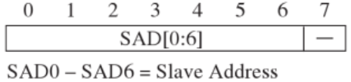



On-board Bus Device Drivers - Pseudocode Examples
I²C Bus Startup (Initialization) on the MPC860
Initialization of I²C registers
Need initialization include the
I²C Mode Register (I²MOD),
I²C Address Register (I²ADD),
the Baud Rate Generator Register (I²BRG),
the I²C Event Register (I²CER), and
the I²C Mask Register (I²CMR)
I²MOD
I²ADD
I²BRG
I²CMR
I²CER

Slide 7
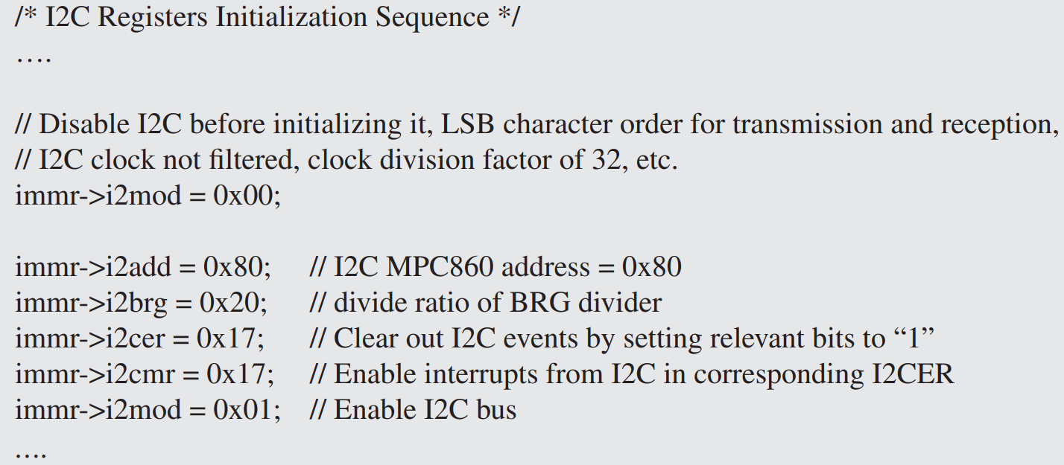
On-board Bus Device Drivers - Pseudocode Examples
I²C Bus Startup (Initialization) on the MPC860
Initialization of I²C registers

Slide 8
On-board Bus Device Drivers - Pseudocode Examples
I²C Bus Startup (Initialization) on the MPC860
Initialization of some of the parameter RAM
Five of the 15 field I²C parameter RAM need to be configured in the initialization of I²C bus on the MPC860.
Receive function code register (RFCR)
Transmit function code register (TFCR)
Maximum receive buffer length register (MRBLR)
Base value of the receive buffer descriptor array (Rbase)
Base value of the transmit buffer descriptor array (Tbase)
RFCR, TFCR - Rx/Tx function code. Contains the value to appear on AT when the associated SDMA channel accesses memory. Also controls the byte-ordering convention for transfers.
MRBLR defines the max. no. of bytes the I²C receiver writes to a receive buffer before moving to the next buffer. Receive buffers should not be smaller than MRBLR.
The receiver writes fewer bytes to the buffer than the MRBLR value if an error or EOF occurs.
Transmitter buffer - not be affected by MRBLR. Vary in size. TxBD[Data Length] - Number of bytes to be sent.

Slide 9
On-board Bus Device Drivers - Pseudocode Examples
I²C Bus Startup (Initialization) on the MPC860
Initialization of some of the parameter RAM
Five of the 15 field I²C parameter RAM need to be configured in the initialization of I²C bus on the MPC860.
Receive function code register (RFCR)
Transmit function code register (TFCR)
Maximum receive buffer length register (MRBLR)
Base value of the receive buffer descriptor array (Rbase)
Base value of the transmit buffer descriptor array (Tbase)
Rbase and Tbase - Rx/TxBD table base address. It should be divisible by eight.
Indicate where the BD tables begin in the dual port RAM.
Setting Rx/TxBD[W] in the last BD in each BD table determines how many BDs are allocated for the Tx and Rx sections of the I²C.
Initialize RBASE/TBASE before enabling the I²C. Furthermore, do not configure BD tables of the I²C to overlap any other active controller’s parameter RAM.

Slide 10
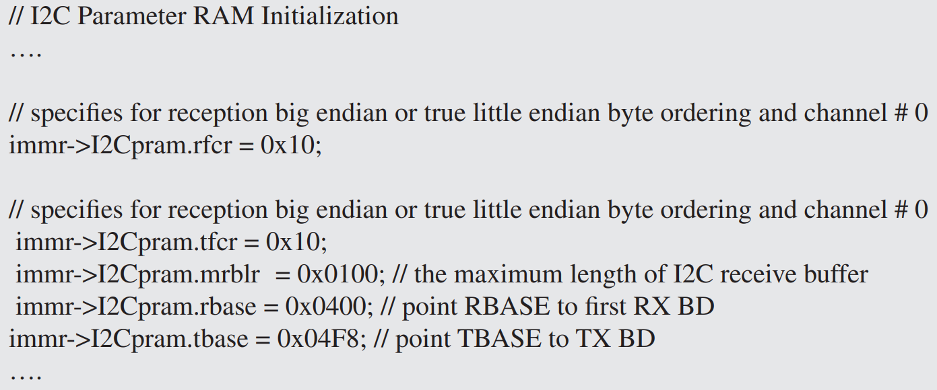
On-board Bus Device Drivers - Pseudocode Examples
I²C Bus Startup (Initialization) on the MPC860
Pseudocode Initialization of some of the parameter RAM

Slide 11
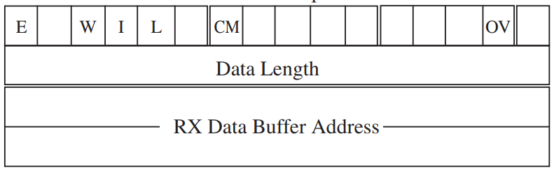
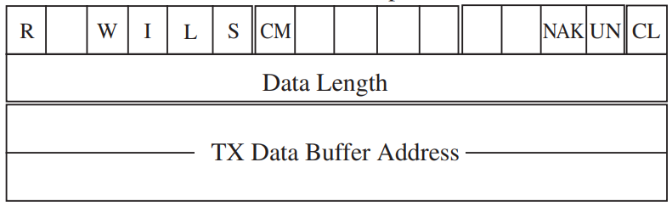
On-board Bus Device Drivers - Pseudocode Examples
I²C Bus Startup (Initialization) on the MPC860
Initialization of I²C buffer descriptor
Data to be transmitted or received via the I²C controller is input into buffers which the transmit and receive buffer descriptors refer to.
The first half word (16 bits) of the transmit and receive buffer contain status and control bits.
Next 16 bits contain the length of the buffer.
Receive buffer descriptor
Transmit buffer descriptor

Slide 12
On-board Bus Device Drivers - Pseudocode Examples
I²C Bus Startup (Initialization) on the MPC860
Initialization of I²C buffer descriptor
Wrap (W) bit indicates whether this buffer descriptor is the final descriptor in the buffer descriptor table.
The Interrupt (I) bit indicates whether the I²C controller issues an interrupt when this buffer is closed.
The Last bit (L) indicates whether this buffer contains the last character of the message.
The Continuous Mode (CM) bit refers to continuous mode in which, if a single buffer descriptor is used, continuous reception from a slave I²C device is allowed.
The CM bit indicates whether the I²C controller clears the Empty (E) bit of the reception buffer or Ready (R) bit of the transmission buffer when it is finished with this buffer.
Transmission buffer, the Ready (R) bit indicates whether the buffer associated with this descriptor is ready for transmission.
Transmit Start Condition (S) bit indicates whether a start condition is transmitted before transmitting the first byte of this buffer.

Slide 13
On-board Bus Device Drivers - Pseudocode Examples
I²C Bus Startup (Initialization) on the MPC860
Initialization of I²C buffer descriptor
The NAK bit indicates that the I2 C aborted the transmission because the last transmitted byte did not receive an acknowledgement.
The Underrun Condition (UN) bit - the controller encountered an underrun condition while transmitting data to the associated buffer.
The Collision (CL) bit indicates that the I²C controller aborted transmission because the transmitter lost while arbitrating for the bus.
In the case of the reception buffer, the Empty (E) bit indicates if the data buffer associated with this buffer descriptor is empty.
Overrun (OV) bit indicates whether an overrun occurred during data reception.

Slide 14
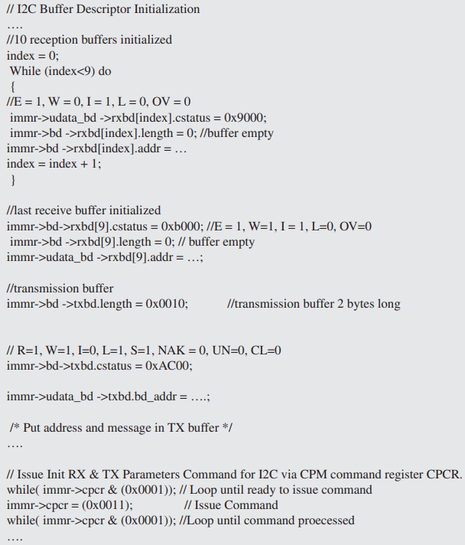
On-board Bus Device Drivers - Pseudocode Examples
I²C Bus Startup (Initialization)
on the MPC860
Initialization of I²C buffer descriptor

Slide 15
Topics Covered
Introduction to On-board Bus Device Drivers
On-board Bus Device Drivers’ Functions
I²C Bus Startup (Initialization) on the MPC860 - Pseudocode Examples
Initializing the I2C bus on the MPC860
Initializing the I²C SDL and SCL pins.
Initializing the I²C registers.
Initializing some of the parameter RAM.
Initializing the buffer descriptors.

